Slide 1
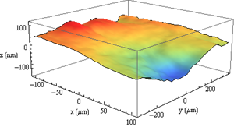
High-Speed Imaging and Optical Sensing Systems for Scientific, Industrial, and Biomedical Applications
Ata Mahjoubfar
Jalali Lab
Electrical Engineering Department, UCLA
NantWorks Lab
California NanoSystems Institute, Los Angeles
[1]
Notes:
We present a novel type of laser scanner that offers 1,000 times higher scan rates than conventional laser scanners. Our method performs inertia-free laser scanning by dispersing a train of broadband pulses both temporally and spatially. As a proof-of-principle demonstration, we perform 1D line scans at a record high scan rate of 91 MHz and 2D raster scans and 3D volumetric scans at an unprecedented scan rate of 100 kHz. To show the utility of our method, we demonstrate imaging, surface vibrometry, and flow cytometry with unique capabilities that conventional methods cannot offer due to their low scan rates.

Slide 2
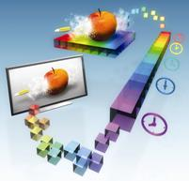

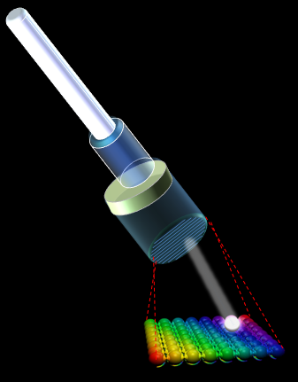
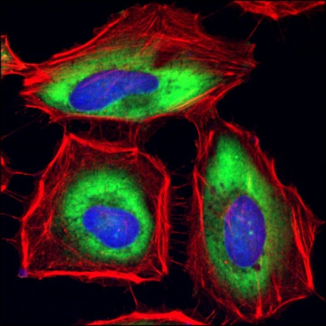
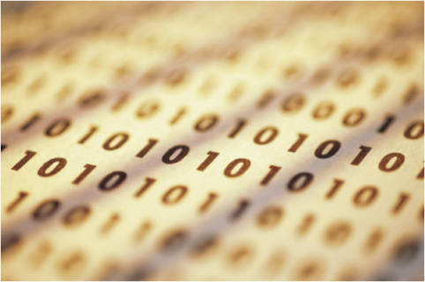
High-throughput real-time measurement instruments for capture and analysis of fast phenomena
Enabling technologies
Optical amplification
Time-stretch
Novel high-throughput systems
Nanometer-resolved vibrometer
Ultrafast 3D Laser scanner
Label-free imaging flow cytometer
Big-data challenge
Quadrature demodulation for real-time processing

Slide 3
High-throughput real-time measurement instruments for capture and analysis of fast phenomena
Enabling technologies
Optical amplification
Time-stretch
Novel high-throughput systems
Nanometer-resolved vibrometer
Ultrafast 3D Laser scanner
Label-free imaging flow cytometer
Big-data challenge
Quadrature demodulation for real-time processing

Slide 4
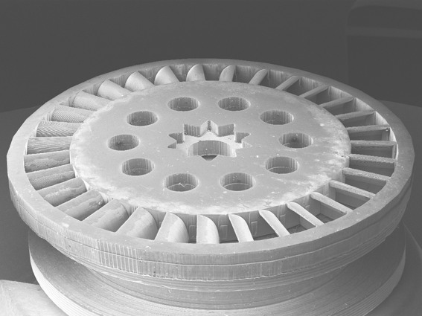
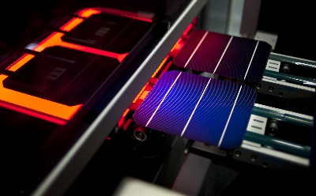
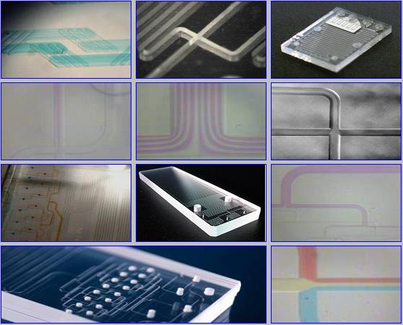
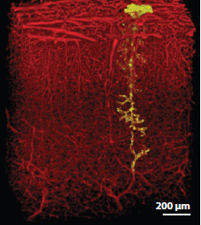
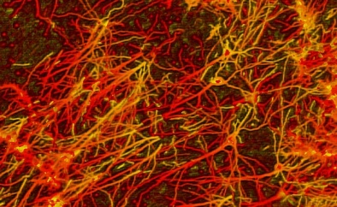
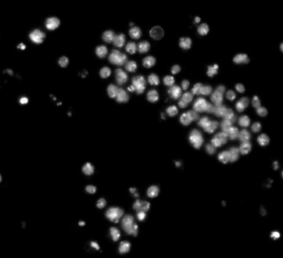
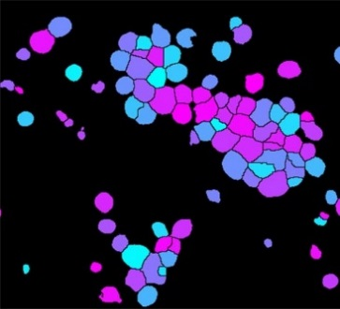
Need for high-throughput imaging and microscopy
Manufacturing inspection
Microfluidic biochips
Monitoring neural activity
Image cytometry

Slide 5
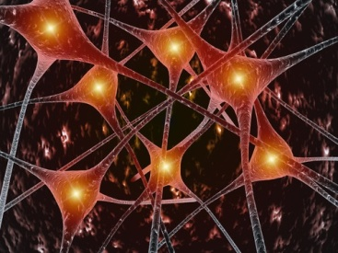
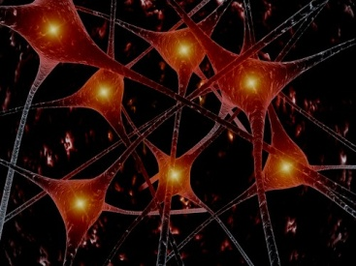
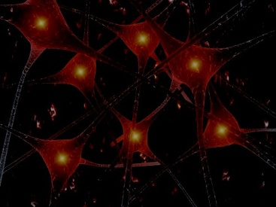
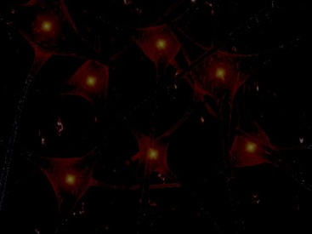
Speed-sensitivity tradeoff, a challenge in high-throughput imaging and microscopy
Scanning larger field-of-view = Collecting less power per pixel
High-intensity illumination
Causes damage to biological samples
Amplified detectors such as photomultiplier tubes (PMTs)
Limited bandwidth reduces speed
Speed
Sensitivity
Notes:
Imaging: For a fixed scan-rate, larger the field-of-view, smaller the time spend on each pixel to collect light; for example in two-photon microscopy, laser scanning confocal microscopy, and scanning fluorescence microscopy. Therefore, the average collected optical power per pixel drops.
A high intensity illuminator could compensate for the sensitivity loss. However, this approach is not suitable for biological sensing as the light is focused onto a very small field-of-view, resulting in extremely high intensity and damaging the sample.
Bandwidth of PMTs is limited to few GHz because of limit on transit time spread.

Slide 6
Optical amplification useful in thermal noise limit
i
Collected Optical Signal
Thermal Noise
Photodetector
Signal + Shot Noise
ii
Frequency
Collected Optical Signal
Amplified Signal + Amplified Shot Noise + Optical Postamplifier Noise
Thermal Noise
Optical Postamplifier
Photodetector
Frequency
i
ii
Thermal or ASE-ASE Noise Limited
SNR ∝ P²
Thermal Noise
Limited
SNR ∝ P²
Signal-to-Noise Ratio (SNR)
Signal-to-Noise Ratio (SNR)
RIN or DRB Noise Limited
SNR ∝ constant
Sensitivity Improvement
Shot Noise
Limited
SNR ∝ P
Sensitivity Improvement
ASE-S Noise Limited
SNR ∝ P
Collected Optical Power (P)
Collected Optical Power (P)
Notes:
To capture high speed phenomena means to have a larger slow-down factor in time-stretch, or to have less time per pixel in scanning microscopy techniques. In both cases, that means lower collected optical power per point, and as a result, going into thermal noise limited region.

Slide 7
Raman amplifiers best choice among conventional optical amplifiers
Type of Amplifier | Advantages | Disadvantages
Rare-earth doped fiber amplifier (e.g. EDFA) | High gain Reasonable noise figure Broad bandwidth | Available only for a few discrete wavelength bands
Semiconductor optical amplifier (SOA) | Available in different wavelength bands Electrically pumped Small size Low cost | Highly nonlinear at high speed High noise figure
Raman amplifier | Low noise figure Available at any wavelength as long as a pump is available | High pump power required

Slide 8
Stimulated Raman scattering transfers energy from pump to Stokes wavelength
Virtual Energy State
Optical Fiber (Gain Medium)
Output (Stokes)
Input
(Stokes)
Amplified Output Signal
Input Signal
Pump
Signal/Pump Duplexer
Signal/Pump Duplexer
First Excited Vibrational State
Forward Pump In
Backward Pump Out
Backward Pump In
Forward Pump Out
Ground State
Notes:
Raman amplification is an optical process based on the phenomenon of stimulated Raman scattering (SRS) in which the input field (called the Stokes field) stimulates the inelastic scattering of a blue-shifted pump field inside an optical medium mediated by its vibrational modes (optical phonons).
A typical Raman amplifier consists of a single-mode silica fiber (gain medium), an input at the Stokes frequency, and one or two pump fields that couple into and out of the fiber via duplexers such as wavelength-division multiplexers or dichroic beamsplitters.

Slide 9
Biological sensing and imaging window in 800 nm band
Rayleigh Scattering
Optical Biological Sensing and Imaging Window
Water Absorption
Attenuation
Less Scattered Signal
High-power Ti-sapphire Lasers
Deeper Penetration Depth
Wavelength (nm)

Slide 10
Experimental setup of Raman amplifier at 808 nm
Raman gain medium: 5 km long Ge-doped glass single-mode fiber with 4 μm mode-field diameter
Weak CW light at 808 nm
Powerful CW light at 788 nm
(~200 mW)

Slide 11
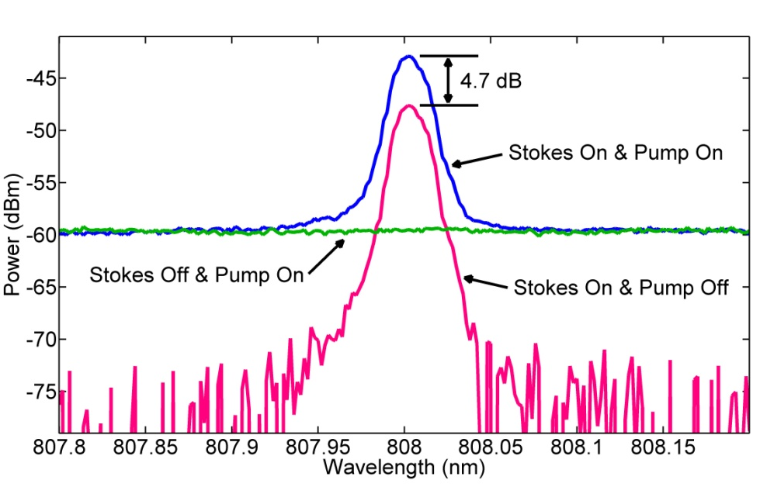
Raman amplification in the 800 nm band for the first time
On-off Raman gain of 4.7 dB

Slide 12
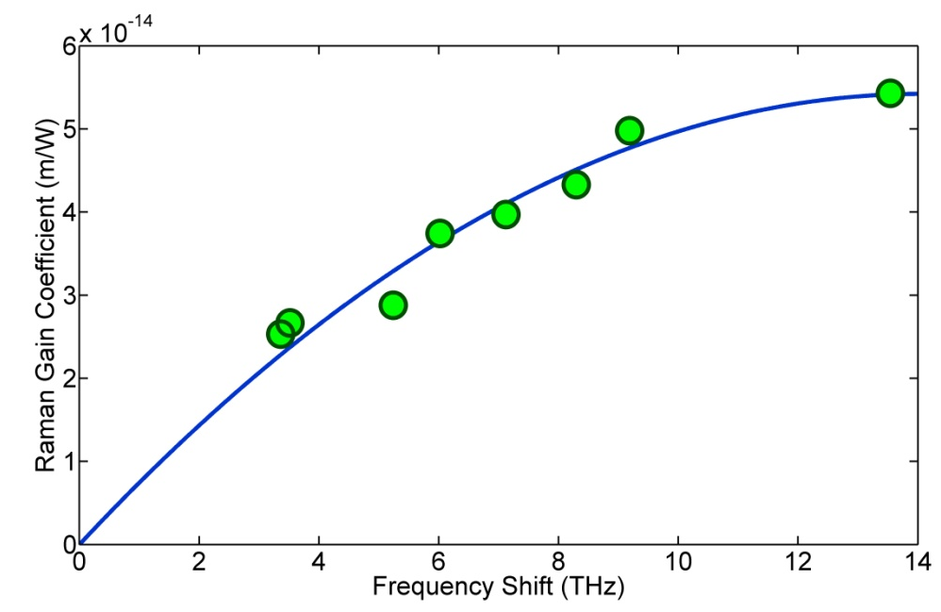
Raman gain coefficient peaks at expected 14 THz frequency shift

Slide 13
High-throughput real-time measurement instruments for capture and analysis of fast phenomena
Enabling technologies
Optical amplification
Time-stretch
Novel high-throughput systems
Nanometer-resolved vibrometer
Ultrafast 3D Laser scanner
Label-free imaging flow cytometer
Big-data challenge
Quadrature demodulation for real-time processing

Slide 14
Time-stretch ultra-short optical pulses to slow down fast phenomena
+
=
t
t
Spectral mapping of information
Group velocity dispersion
Photodetector and real-time digitizer
Modulation Transmission Detection
+ Optical Amplification
Tradeoff
Speed
Sensitivity
Notes:
Information can be stamped (mapped) onto the spectrum of ultra-short optical pulses.
As we going to measurement of higher speed information, we need to stretch the pulses more, and for the same frame-rate, the average optical power per measurement pixel drops.

Slide 15
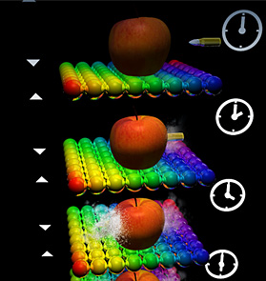
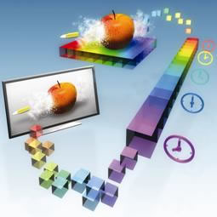
Time-stretch imaging/microscopy
Developed by Jalali-lab at UCLA (Nature, 2009)
Stretched Time-Encoded Amplified Microscopy (STEAM)
Based on spectrally encoded imaging and Amplified Time-stretch Dispersive Fourier Transform (ADFT)
Known as the world’s fastest continuous-time camera
Main Features:
Ultrafast shutter speed: ~50 ps
Low light illumination: ~10 mW
High sensitivity: ~30 dB optical image amplification
Real-time digitizing: 50 GS/s
Notes:
Echo: applying to biological imaging, which is time-stretch microscopy developed previously in our group, 2009.
Based on … and … go into details in next slide
World fastest ..
Four main features: freeze the motion; not cook the cell; amplification to compensate the low number of photons collected during the ultra-short shutter time; photonic time stretch for digitizing fast images in real-time
Frame rate: ~10s of million frames/second
Shutter speed: ~50 ps [ps, compared to 100 ns for ultrafast CMOS cameras ] [This fast shutter speed is crucial for avoiding image blurring caused by the fast moving cell. ]
Optical image gain: ~30 dB (~1000 times)
5 ms for 250 MB (@50GS/s,8bit)
40 min for 12 TB (@3GS/s,12bit)

Slide 16
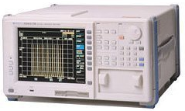
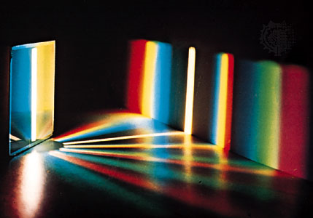
STEAM is combination of spectrally encoded imaging with …
Wavelength
Wavelength
Sample
Wavelength
Spatial Dispersion
Space
Space
Space
VIPA
Diffraction Grating
Optical Spectrum Analyzer
Conventional spectrally encoded imaging
Notes:
Optical spectrum analyzer is slow in spectrally encoded imaging. We replace it with our high-speed spectrometer.
STEAM stands for Serial time-encoded amplified imaging/microscopy.
VIPA stands for virtually-imaged phased array

Slide 17
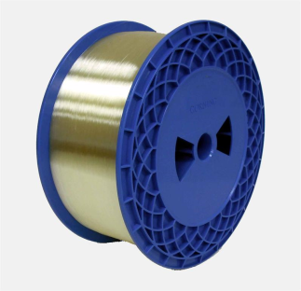
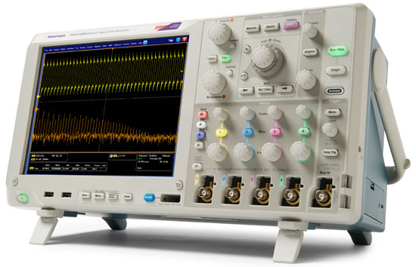
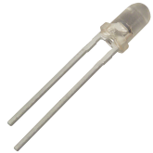
STEAM is combination of spectrally encoded imaging with amplified time-stretch
Wavelength
Wavelength
Sample
Wavelength
Spatial Dispersion
Space
Space
Space
Dispersive Fiber
Photodetector
Wavelength
Temporal Dispersion
Wavelength
Time
Optical Pump
Time
Real-time Digitizer
Notes:
Optical spectrum analyzer is slow in spectrally encoded imaging. We replace it with our high-speed spectrometer.
STEAM stands for Serial time-encoded amplified imaging/microscopy.
VIPA stands for virtually-imaged phased array

Slide 18
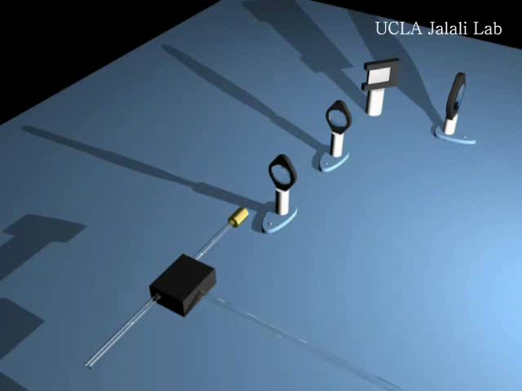
STEAM operation principle in a video
Shutter speed = Pulse width (sub nanosecond)
Frame rate = Pulse repetition rate (10s of million frames/s)
Pixel readout rate = Sampling rate of ADC
(several billion pixels/s)
Resolution limit = Diffraction-limit of objective lens
(sub micrometer)
Goda et. al., Nature, 2009

Slide 19
High-throughput real-time measurement instruments for capture and analysis of fast phenomena
Enabling technologies
Optical amplification
Time-stretch
Novel high-throughput systems
Nanometer-resolved vibrometer
Ultrafast 3D Laser scanner
Label-free imaging flow cytometer
Big-data challenge
Quadrature demodulation for real-time processing

Slide 20
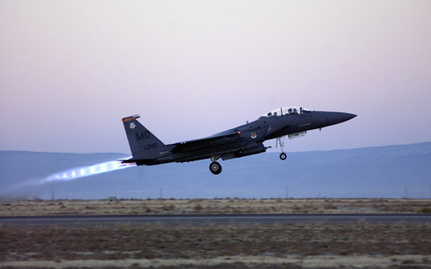

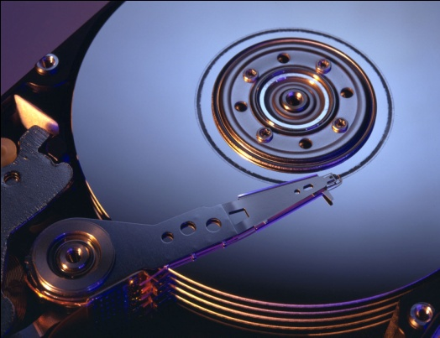

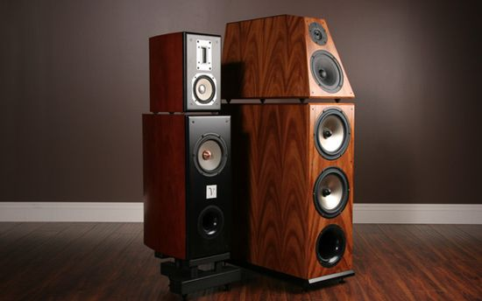
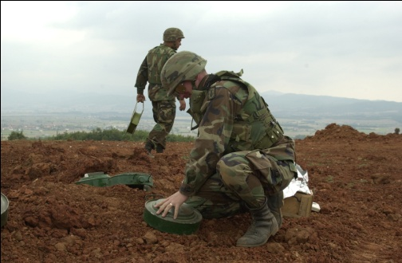
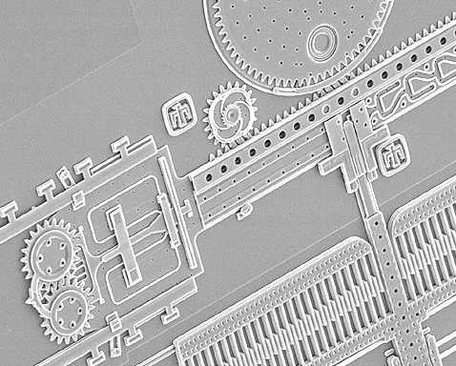
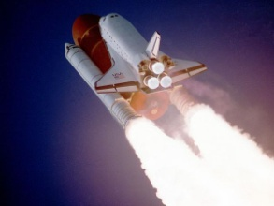
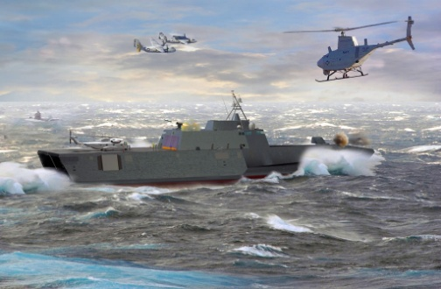
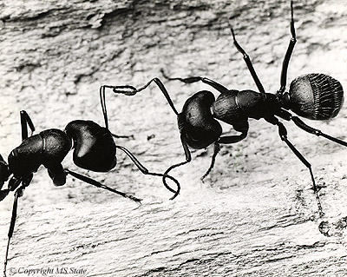
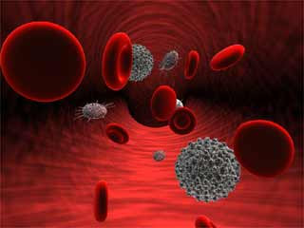
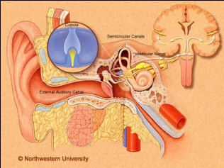
Wide range of application for vibrometers
Industrial applications
Inspection of aircraft components
Diagnosis of automotive structural dynamics and brake performance
Hard disk drive diagnostics
Performance of musical instruments and loud speakers
Military applications
Detection of buried landmines
Scientific applications
Inspection of microelectromechanical (MEMS) devices
Monitoring of fluid dynamics in aerospace and naval applications
Insect communication
Biomedical applications
Non-invasive quantification of blood flow
Eardrum diagnostics

Slide 21
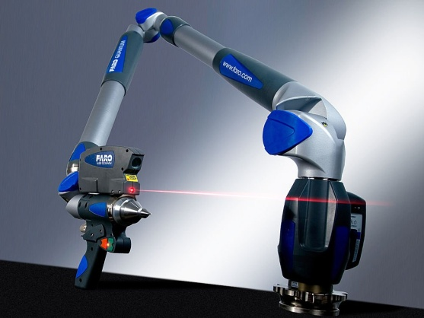
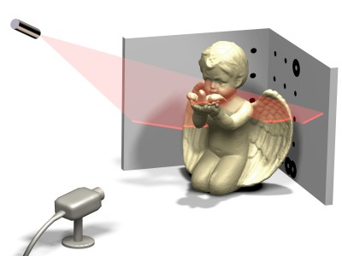
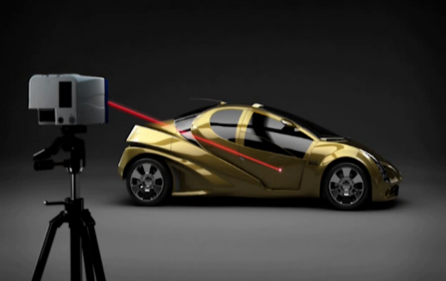
Limitations of conventional laser vibrometers
Rely on beam scanning for spatial maps of vibration
Maximum scan rate: ~100 KHz in 1D, ~1 KHz in 2D
Introduced an imaging laser vibrometer:
More than 100 times higher scan rate
Nanometer-scale axial resolution
Notes:
Conventional laser vibrometers are unable to perform imaging-based vibrometry at high speeds because their operation builds on single-point measurements and relies on beam scanning for multi-dimensional laser vibrometry. Currently, the maximum scan rates provided by conventional laser vibrometers (e.g., galvanometric mirror scanners and acousto-optic deflectors) are ~100 kHz in 1D (line scans) and ~1 kHz in 2D (raster or spiral scans).
We demonstrate a laser vibrometer that achieves imaging-based surface vibration measurements with nanometer-scale axial resolution at ~100 times higher scan rates than the conventional methods.

Slide 22
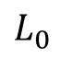
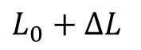
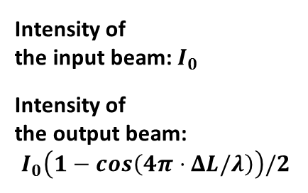
Vibrometry by STEAM imaging of optical path difference
Reference
Mirror
Michelson Interferometer
Reference Mirror
Femtosecond Pulse Laser
Diffraction Grating
Beam
Splitter
Target
$$L_{0}$$
Sample
50:50
Beam
Splitter
Nonlinear Fiber
Input
Output
$$L_{0}+ΔL$$
Optical Filter
Beam Blocker
Diffraction Grating
Intensity of the input beam: $I_{0}$
Intensity of the output beam: $$I_{0}\left(1−cos\left(4π⋅ΔL/λ\right)\right)/2$$
Optical Circulator
Fiber Coupler
Dispersive Fiber
Photodiode
Digitizer
Amplified Time-Stretch
Notes:
~100 times higher scan rates than the conventional methods, ~1 nm axial resolution, ~170 resolvable points, and 30 ps dwell time (no blurring) at 36.7 MHz scan rate (freezes the motion).

Slide 23
STEAM vibrometer achieves high scan rate by time-stretch technology
36 MHz scan rate

Slide 24
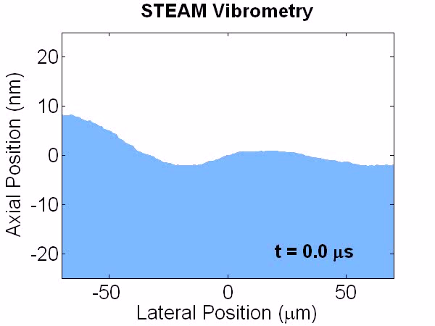
Surface vibration of a silicon wafer driven by a 30 kHz acoustic wave
1 nm axial resolution
170 resolvable points
30 ps dwell time (no blurring)

Slide 25
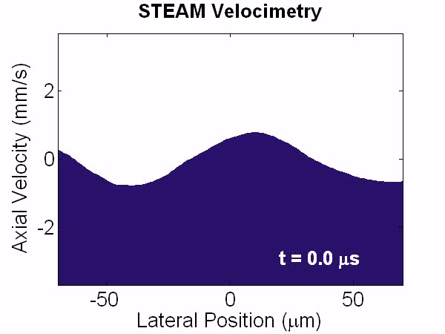
The superior temporal resolution of STEAM vibrometer enables velocimetry

Slide 26
High-throughput real-time measurement instruments for capture and analysis of fast phenomena
Enabling technologies
Optical amplification
Time-stretch
Novel high-throughput systems
Nanometer-resolved vibrometer
Ultrafast 3D Laser scanner
Label-free imaging flow cytometer
Big-data challenge
Quadrature demodulation for real-time processing

Slide 27
Combination of STEAM and AOD for 2D scans
Scan rate limited to ~100 KHz by AOD
Wavelength-to-Space Mapping
Target
Cylindrical Lens
Diffraction Grating
Digitizer
Acousto-Optic Deflector (AOD)
Mirror
Vertical Scan (Slow Axis)
Photodetector
Diffraction Grating
Optical Circulator
Horizontal Scan (Fast Axis)
Single-Pixel Detection
Target
Mirror
Dispersive Fiber
Prism
Prism
Ti:Sapphire Laser
Prism
Prism
Wavelength-to-Time Mapping
Notes:
To show the compatibility of HDLS with other methods, we combined it with AOD in our 2d demonstration.

Slide 28
Used an interferometer, to measure axial profile and achieve 3D scans
Reference Mirror
Beamsplitter
Scanner Pulses
Vibrating Diaphragm

Slide 29
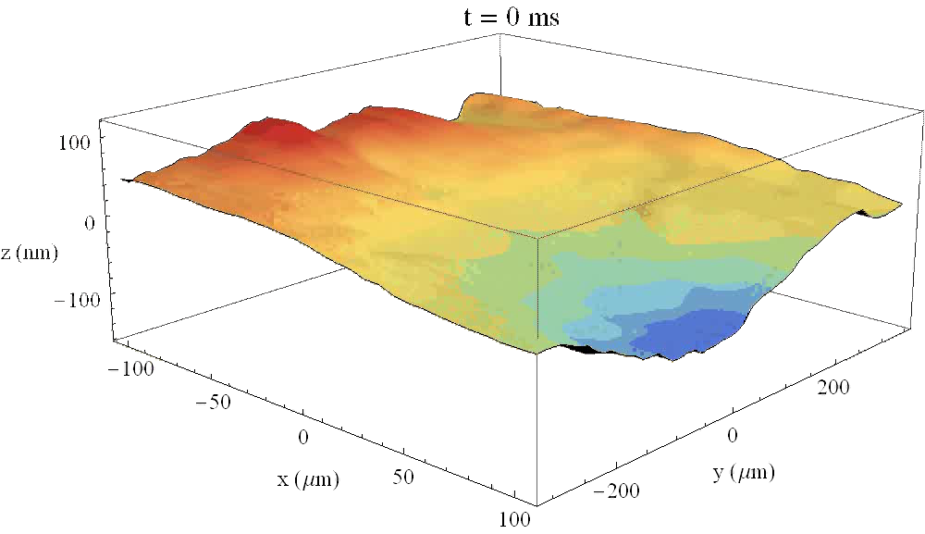
3D profilometry or 2D vibrometry of a diaphragm vibrating at 1 kHz vibration

Slide 30
High-throughput real-time measurement instruments for capture and analysis of fast phenomena
Enabling technologies
Optical amplification
Time-stretch
Novel high-throughput systems
Nanometer-resolved vibrometer
Ultrafast 3D Laser scanner
Label-free imaging flow cytometer
Big-data challenge
Quadrature demodulation for real-time processing

Slide 31
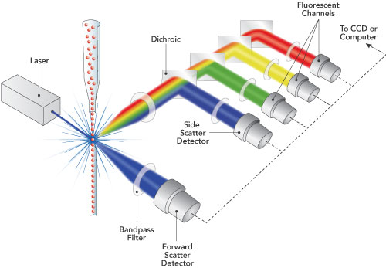
Flow cytometry, a tool for classification of cells in flow
Side Scattering
Forward Scattering
Fluorescent Channel 2
Forward scattering: size
Side scattering: granularity and complexity
Fluorescent signals: presence of biomarkers
Fluorescent Channel 1

Slide 32
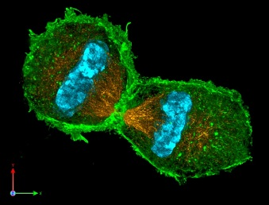
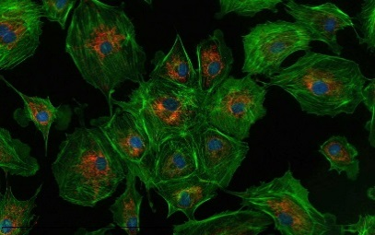
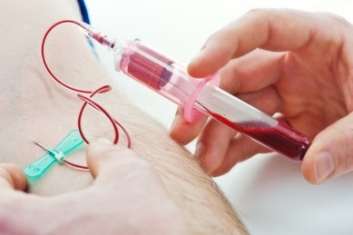
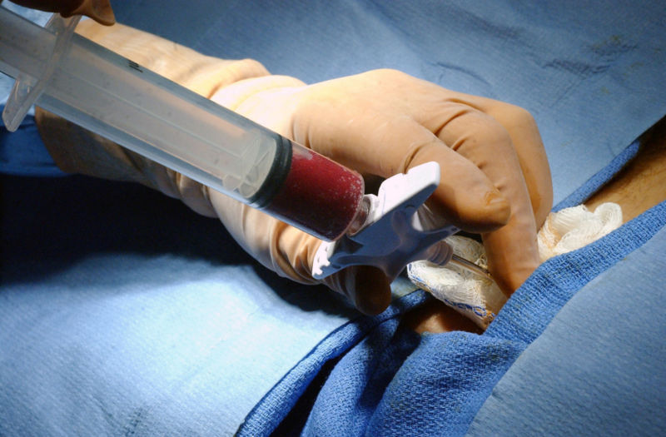
Shortcomings of conventional flow cytometers
Scattering signals: inaccurate descriptors of cell morphology
Fluorescent cell labels: negatively impact cellular viability stimulate activating/inhibitory signals alter cell behavior: a problem for downstream analysis
Our approach: label-free quantitative phase and intensity imaging in flow enabled by stretched time-encoded amplified microscopy (STEAM)
Blur-free imaging by sub nanosecond shutter speed: full morphology
Protein concentration derived from quantitative phase images: additional biophysical parameter for label-free cell classification

Slide 33



Coherent-STEAM for simultaneous quantitative phase and intensity microscopy
Up to 100,000 cell/s
Sample Inlet
Sheath Inlet
Outlet
Sheath Inlet
Sample Inlet
Hydrodynamic Focusing
Outlet
STEAM
Rainbow
Sheath Inlet
Source and Detector

Slide 34


Intensity and phase images from a single interferogram
$$I\left(t\right)=I_{r}\left(t\right)+I_{s}\left(t\right)+2\sqrt{I_{r}\left(t\right)I_{s}\left(t\right)}\cos\left(\frac{4π}{λ\left(t\right)} Δnz\left(t\right)\right)$$
Beyond
diffraction- limit

Slide 35

Wavelength components probe the cells horizontally, while consecutive pulses probe them vertically

Slide 36

Intensity image corresponds to cell scattering; phase image corresponds to optical path difference
Flow Direction
100 μm
Diameter
Flow Direction
100 μm
Total Scattering
Flow Direction
100 μm
Refractive Index
Flow Direction
100 μm

Slide 37


Calibration with NIST traceable Polystyrene beads

Slide 38

Protein concentration improves label-free cell classification accuracy
SW480: colon epithelium cancer cells
Detection Limit
OTII: T lymphocyte hybridoma cells
Detection Limit
Counts
Protein Concentration (A.U.)
Cell Diameter (μm)
Cell Diameter (µm)
Notes:
Protein concentration, as an additional biophysical parameter, improves label-free cell classification accuracy

Slide 39


More biophysical parameters, higher sensitivity
Receiver Operating Characteristic
$$\text{Sensitivity}\text{ =} \frac{\text{True} \text{P}\text{ositive}}{\text{Positive}}$$
False negative events reduce sensitivity.
$$\text{Specificity}\text{ = }\frac{\text{True} \text{Negative}}{\text{Negative}}$$
False positive events reduce specificity.
True Positive Rate (Sensitivity)
Multi-parameter Coherent-STEAM
Diameter only
Protein concentration only
Scattering only
Random guess
False Positive Rate (1 - Specificity)

Slide 40
High-throughput real-time measurement instruments for capture and analysis of fast phenomena
Enabling technologies
Optical amplification
Time-stretch
Novel high-throughput systems
Nanometer-resolved vibrometer
Ultrafast 3D Laser scanner
Label-free imaging flow cytometer
Big-data challenge
Quadrature demodulation for real-time processing

Slide 41
Challenges in processing big data of Coherent-STEAM
Need at least 12 GS/s
Impractical to digitally perform in real-time complicated signal processing of Coherent-STEAM
10 mL of sample
At 45 μL/min injection rate: 3 hours and 43 minutes
For an 8-bit ADC: 160 TB
Too big for post processing
Beyond
diffraction- limit
28 μm
45 μL/min
19 μm
Notes:
Sample flow width is about 19.29 micrometer for a 100 micron channel wide and 1 and 3 mL BD plastic syringes pushed with the same pump.

Slide 42


Analog preprocessing of Coherent-STEAM signals by quadrature demodulation
Amplitude
27 ns
Mixer
Amplitude
~
time
~
I
Magnitude
200 ps
27 ns
cos(2πf₀t)
Low-pass filter
(0 – 0.75 GHz)
Amplitude
200 ps
$$π/4$$
time
1 GHz
frequency
Coherent-STEAM Signal
~
~
Magnitude
~
time
Amplitude
Band-pass filter
(4.5 – 5.5 GHz)
27 ns
Local Oscillator
f₀ = 5 GHz
$${−π}/4$$
0.6 GHz
sin(2πf₀t)
frequency
~
time
1 GHz
5 GHz
~
Q
Magnitude
Mixer
Low-pass filter
(0 – 0.75 GHz)
1 GHz
frequency

Slide 43
Digital signal processing of I and Q channels for real-time cell sorting
Enough for saving images of all cells in 10 mL sample
Dual-channel Digitizer
12 TB RAID 0 Hard-disk Array
(2 x 8-bit Samples at 1.5 GS/s = 3 GB/s)
Amplitude
27 ns
FPGA
time
I
1.5 GS/s, 8-bit A/D Ch1
…
Frame FIFO
…
…
Samples
I frames
Frames
(each 49 samples)
Amplitude
Unwrapped Angle(I/Q)
27 ns
Trigger
Cell
Sorter
time
Q frames
Q
1.5 GS/s, 8-bit A/D Ch2
…
Frame FIFO
…
…
Samples
Frames
(each 49 samples)

Slide 44




40 TB of I/Q data can be easily processed to form intensity and phase images
Intensity image of OT-II hybridoma T cells
Flow Direction
100 μm
Phase image of OT-II hybridoma T cells
Flow Direction
100 μm
Intensity image of OT-II hybridoma T cells
Flow Direction
100 μm
Phase image of OT-II hybridoma T cells
Flow Direction
100 μm

Slide 45
Summary
Raman amplification at 800 nm band is demonstrated for the first time.
Nanometer-resolved vibrometry and 3D scanning profilometry with more than 100 times faster throughput than conventional methods is introduced.
Simultaneous phase and intensity imaging flow cytometry is shown to improve label-free cell classification accuracy.
Analog preprocessing of Coherent-STEAM signals with Quadrature demodulation is presented as an effective approach for easing the big data problem and capturing up to 40 TB of cell images in real-time.

Slide 46
Detailed information in my publications
Journal Publications:
J. Adam, A. Mahjoubfar, E. D. Diebold, B. W. Buckley, and B. Jalali, “Spectrally encoded angular light scattering” Optics Express, Vol. 21, No. 23, pp. 28960-28967, 2013. Selected article for Virtual Journal for Biomedical Optics, Vol. 9, No. 1, 2014.
A. Mahjoubfar, K. Goda, G. Betts, and B. Jalali, “Optically amplified detection for biomedical sensing and imaging” Journal of the Optical Society of America A, Vol. 30, No. 10, pp. 2124-2132, 2013.
A. Mahjoubfar, C. Chen, K. R. Niazi, S. Rabizadeh, and B. Jalali, “Label-free high-throughput cell screening in flow” Biomedical Optics Express, Vol. 4, No. 9, pp. 1618-1625, 2013.
K. Goda, A. Mahjoubfar, C. Wang, A. Fard, J. Adam, D. R. Gossett, A. Ayazi, E. Sollier, O. Malik, E. Chen, Y. Liu, R. Brown, N. Sarkhosh, D. Di Carlo, and B. Jalali, “Hybrid dispersion laser scanner” Scientific Reports, Vol. 2, 445, 2012. Highlighted in Nature Photonics, Vol. 6, No. 9, p. 573, 2012.
A. M. Fard, A. Mahjoubfar, K. Goda, D. R. Gossett, D. Di Carlo, and B. Jalali, “Nomarski serial time-encoded amplified microscopy for high-speed contrast-enhanced imaging of transparent media” Biomedical Optics Express, Vol. 2, No. 12, pp. 3387-3392, 2011.
A. Mahjoubfar, K. Goda, A. Ayazi, A. Fard, S. H. Kim, and B. Jalali, “High-speed nanometer-resolved imaging vibrometer \& velocimeter” Applied Physics Letters, Vol. 98, No. 10, 101107, 2011. Selected article for Virtual Journal of Nanoscale Science \& Technology, Vol. 23, No. 11, 2011 and Virtual Journal of Ultrafast Science, Vol. 10, No. 4, 2011.
K. Goda, A. Mahjoubfar, and B. Jalali, “Demonstration of Raman gain at 800 nm in single-mode fiber and its potential application to biological sensing and imaging” Applied Physics Letters, Vol. 95, No. 25, 251101, 2009. Selected article for Virtual Journal of Ultrafast Science, Vol. 9, No. 1, 2010.
Conference publications:
A. Yazaki, A. Mahjoubfar, C. Kim, J. Chan, K. Goda, M. Watanabe, and B. Jalali, “Ultrafast Web-inspecting Laser Scanner” Progress In Electromagnetics Research Symposium, Guangzhou, China, 2014, 140319211016.
C. Chen, A. Mahjoubfar, A. Huang, K. R. Niazi, S. Rabizadeh, and B. Jalali, “Hyper-dimensional analysis for label-free high-throughput imaging flow cytometry” Conference on Lasers and Electro-Optics (CLEO), San Jose, CA, 2014, AW3L.2.
C. Kim, A. Mahjoubfar, A. Yazaki, J. Chan, K. Goda, M. Watanabe, and B. Jalali, “Ultrafast Surface-inspecting Laser Scanner” Far East Forum on Nondestructive Evaluation/Testing, Chengdu, China, 2014.
C. Chen, A. Mahjoubfar, A. Huang, L. Tai, K. R. Niazi, S. Rabizadeh, and B. Jalali, “Hyper-dimensional analysis for label-free high-throughput imaging flow cytometry” XXIX Congress of the International Society for Advancement of Cytometry, Fort Lauderdale, Florida, 2014.
J. Adam, A. Mahjoubfar, E. D. Diebold, B. W. Buckley, and B. Jalali, “Time-stretched spectrally encoded angular light scattering for high-throughput real-time diagnostics” Proceedings of SPIE, Biophotonics: Photonic Solutions for Better Health Care, Brussels, Belgium, 2014, 9129-40.
A. Mahjoubfar, C. Chen, K. R. Niazi, S. Rabizadeh, and B. Jalali, “Label-free high-throughput imaging flow cytometry” Proceedings of SPIE, Frontiers in Ultrafast Optics: Biomedical, Scientific, and Industrial Applications XIV, San Francisco, CA, 2014, 89720F.
A. Mahjoubfar, K. Goda, C. Wang, A. Fard, J. Adam, D. R. Gossett, A. Ayazi, E. Sollier, O. Malik, E. Chen, Y. Liu, R. Brown, N. Sarkhosh, D. Di Carlo, and B. Jalali, “3D ultrafast laser scanner” Proceedings of SPIE, Frontiers in Ultrafast Optics: Biomedical, Scientific, and Industrial Applications XIII, San Francisco, CA, 2013, 86110N.
A. Fard, A. Mahjoubfar, K. Goda, and B. Jalali, “Nomarski serial time-encoded amplified microscope for high throughput imaging of transparent media” Conference on Lasers and Electro-Optics (CLEO), Baltimore, MD, 2011, CThW1.
K. Goda, A. Mahjoubfar, A. Ayazi, A. Fard, S. H. Kim, and B. Jalali, “High-speed nanometer-resolved imaging-based laser vibrometry” Conference on Lasers and Electro-Optics (CLEO), Baltimore, MD, 2011, JWA78.
A. Mahjoubfar, K. Goda, and B. Jalali, “Raman amplification at 800 nm in single-mode fiber for biological sensing and imaging” Conference on Lasers and Electro-Optics (CLEO), San Jose, CA, 2010, CFA4.

Slide 47
Acknowledgements
My advisor, Prof. Bahram Jalali
Prof. Kayvan R. Niazi and Prof. Shahrooz Rabizadeh (biology)
Prof. Katsushi Arisaka (PMTs and HPDs)
Prof. Tatsuo Itoh (photons in microwave band)
Prof. Benjamin Williams (quantum mechanics)
Prof. Dean Ho (short notice)
Our team at CNSI NantWorks lab: Claire Chen, Jim Lin, Jerry Tai, Allen Huang
Prof. Keisuke Goda (persistence)
Dr. Daniel Solli (optical alignment)
Dr. Eric Diebold (microscopy)
Dr. Daniel R. Gossett (microfluidic channel fabrication)
Arash Mirhaj (noise in electronics)
My parents
Notes:
taught me unteachable

Slide 48
Questions?
More questions? Feel free to email me at ata.m@ucla.edu.

Slide 49
Theory of Raman amplification
Raman gain coefficient (m/W)
Loss coefficients of the fiber at the Stokes and pump wavelengths
Intensities of Stokes and pump fields
Undepleted Pump
Bidirectional pumping:
Net gain:
Forward pump, backward pump, and Stokes field powers
Mode field diameter in the fiber at pump and Stokes Wavelengths
Length of the fiber

Slide 50

Limiting noise sources (1)
Double Rayleigh backscattering (DRB) noise
Rayleigh scattering is the elastic scattering of light by particles with dimensions which are much smaller than the wavelength of the light.
While most of the scattered light escapes through the cladding, a small portion of the light can stay in the fiber core and propagate backward in the fiber.
This backward-propagating scattered light is normally very weak, but it can be amplified by distributed Raman amplification in the fiber, and it can again be scattered and propagate along with the signal in the forward direction.
DRB causes a delayed crosstalk, in-band noise, that is amplified by the process of SRS in the fiber.
Rayleigh baskscattering coefficient
Responsivity of the photodetector

Slide 51
Limiting noise sources (2)
Pump-to-Stokes relative intensity noise (RIN) transfer
Intensity fluctuations of pump lasers (RIN)
Variations of the amplifier net gain in time
RIN of the pump is transferred into the amplified signal
RIN Coefficients of the forward and backward pump laser
Group velocities of Stokes and pump fields
Electrical bandwidth of the photodetector
RIN Coefficients of the amplified signal

Slide 52
Limiting noise sources (3)
Amplified spontaneous emission noise
The random spontaneously Raman-shifted emitted light is amplified by the process of stimulated emission.
These photons have random phases relative to the signal and appear as noise.
Beating of the Stokes field with the ASE:
Beating of the ASE with itself:
Spectral density of the ASE
Optical bandwidth of the photodetector
Population inversion factor
Temperature of the gain medium

Slide 53
Limiting noise sources (4)
Detection noise:
Thermal noise (also called Johnson-Nyquist noise) is produced by the thermal agitation of the electrons inside the load resistor.
Shot noise originates from the fluctuations of detected photons and is a direct consequence of the quantum nature of photons.
Dark current noise is due to the random generation of free carriers within the depletion region of the photodiode, even when it is not exposed to light.
Load resistance of the photodetector circuit
Average dark current through the photodiode

Slide 54
Noise current variances (1)
Name | Parameter | Unit | Value
Reduced Planck Constant |  | J∙s
Boltzmann Constant |  | J/K
Elementary Charge |  | C
Stokes Wavelength |  | nm | 800
Pump Wavelength |  | nm | 773.2
Fiber Attenuation at Stokes Wavelength |  | m
Fiber Attenuation at Pump Wavelength |  | m
Raman Gain Coefficient |  | m/W
Group Velocity at Stokes Wavelength |  | m/s
Group Velocity at Pump Wavelength |  | m/s
Mode Field Diameter at Stokes Wavelength |  | μm | 5.52
Mode Field Diameter at Pump Wavelength |  | μm | 5.34
Fiber Length |  | m | 1040
Temperature of Raman Gain Medium |  | K | 300
Rayleigh Backscattering Coefficient |  | km
Forward Input Pump Power |  | mW | 200
Backward Input Pump Power |  | mW | 200
Forward Pump Relative Intensity Noise |  | Hz
Backward Pump Relative Intensity Noise |  | Hz
Photodiode Responsivity |  | A/W | 0.5
Load Impedance |  |  | 50
Photodiode Dark Current |  | nA | 20
Optical Bandwidth of Photodetector |  | THz | 0.5
Electrical Bandwidth of Photodetector |  | MHz | 100

Slide 55

Noise current variances (2)

Slide 56
Sensitivity enhancement by optical post-amplifier
The signal-to-noise ratio (SNR) of the detection system is given by the power of the signal current over the total noise current variance:
The use of the Raman amplifier improves the sensitivity of the photodiode detection system by 19.4 dB.
The combination of the Raman amplifier and APD does not improve the sensitivity significantly (only 6.1 dB) because the APD’s internal gain is meant to overcome the thermal noise of the detector.
19.4 dB
9.1 dB
The combination of the Raman amplifier and photodiode is better in sensitivity than an APD alone by 9.1 dB.
6.1 dB

Slide 57
Sensitivity improvements at various wavelengths (1)
Parameter | Unit | Value
 | nm | 500 | 600 | 700 | 800 | 900 | 1000
 | nm | 489.4 | 584.8 | 679.4 | 773.2 | 866.2 | 958.4
 | μm | 3.5 | 4.2 | 4.9 | 5.5 | 6.2 | 6.9
 | μm | 3.4 | 4.1 | 4.7 | 5.3 | 6.0 | 6.6
 | pm/W | 1.79 | 1.06 | 0.674 | 0.457 | 0.324 | 0.238
 | mW | 200 | 175 | 175 | 200 | 250 | 400
 | mW | 200 | 175 | 175 | 200 | 250 | 400
 | m | 100 | 270 | 610 | 1040 | 1420 | 1360
 | dB | 17.6 | 18.2 | 18.8 | 19.4 | 20.0 | 20.6
 | dB | 7.3 | 7.9 | 8.5 | 9.1 | 9.7 | 10.3
 | dB | 4.2 | 5.5 | 6.1 | 6.1 | 6.7 | 7.3
 | nW | 533.67 | 533.67 | 533.67 | 533.67 | 533.67 | 533.67
 | nW | 9.33 | 8.11 | 7.05 | 6.14 | 5.34 | 4.64
 | nW | 49.77 | 49.77 | 49.77 | 49.77 | 49.77 | 49.77
 | nW | 1.87 | 1.42 | 1.23 | 1.23 | 1.07 | 9.33

Slide 58
Sensitivity improvements at various wavelengths (2)
The sensitivity improvement and minimum detectable power reach the optimum levels at certain pump powers beyond which they cannot be improved any more because DRB noise limiting region has reached.

Slide 59
Time-stretch technology: Stretching the time for ultra-short optical pulses
+
=
t
t
Spectral mapping of information
Group velocity dispersion
Photodetector and real-time digitizer
Modulation Transmission Detection
+ Optical Amplification
Tradeoff
Speed
Sensitivity
Notes:
Information can be stamped (mapped) onto the spectrum of ultra-short optical pulses.

Slide 60

Fiber optics of Coherent STEAM

Slide 61


Microfluidic channel mask
Outlet
Sample Inlet
Sheath
Inlet

Slide 62
Protein concentration calculation from optical path difference (OPD)

Slide 63
STEAM vibrometry & velocimetry resolution
The number of image pixels on the target : D = -1200 ps/nm, Δλ = 20 nm, f_{dig} = 50 GS/s:
The number of resolvable points is limited by the spectral resolution of the ADFT process:
The axial resolution is given by the bit depth of the digitizer (n = 8):
Dispersion
Sampling rate of the digitizer
Optical bandwidth
Speed of light
Bit depth of the digitizer

Slide 64
Signal-to-Noise ratio of 3 dB is used for detection limit calculations.
36 Million Frames
per Second
Notes:
Noise sources: Quantization, Double Rayleigh Back-scattering, ASE-ASE, ASE-Signal, Thermal, Shot, Dark, Relative Intensity Noise Transfer
Parameters: wavelength 1580-1600 nm, pump wavelength 1490 nm, forward pump power 200 mW, backward pump power 200 mW, forward pump RIN 0.1% over 10 MHz, , backward pump RIN 0.1% over 10 MHz, temperature 298.15 K, Electrical bandwidth 10 GHz, Optical bandwidth 20 nm, Responsivity 0.7 A/W, Gain M=7, Excess Noise 3 dB, Rohm = 500 Ohm, Dark current 0.8 mA, fiber length 10 km, dispersion -1412 ps/nm, Net gain 10 dB.
On the upper left corner, SNR degrades away from the center because at the edges of the pulse, the signal doesn not fill up the full scale of quantizer, and the optical SNR is also lower.

Slide 65
Signal-to-Noise ratio of 3 dB is used for detection limit calculations.
36 Million Frames
per Second
3.6 Million Frames
per Second
0.36 Million Frames
per Second
ENOB = 9 Bits
Notes:
For ENOBs larger than 9 bits, the sensitivity does not improve because we are optical noise limited.
Median filter is much better than moving average because it can ignore sudden glitches in the signal. So, I used median filter for these plots.
For filter orders larger than ~30, the sensitivity does not improve beyond ~0.5 nm. I guess the reason is that we are reducing the sinusoidal vibration signal energy (this signal is at 30 KHz).

Slide 66
Hybrid dispersion laser scanner (HDLS) is based on probing with spatially-dispersed chirped optical pulses.
Wavelength
Wavelength
Wavelength
Space
Space
Space
Wavelength-to-
Time Mapping
Wavelength-to-Space Mapping
Time
Time
Time
Prism Pairs
Dispersive Fiber
Virtually Imaged Phase Array
Diffraction Grating
t
t

Slide 67

Prism pairs and dispersive fiber perform a linear one-to-one mapping between spectrum and time.
Time (ns)
11 ns
Voltage (mV)
Voltage (mV)
Power (nW)
Time (ns)
Wavelength (nm)
Time Delay (ns)
Wavelength (nm)
Notes:
GVD = -123 ps/nm/km
Of course a conventional optical spectrum analyzer is not fast enough to capture spectrum of every single pulse, and red curve is average spectrum of many pulses.

Slide 68

HDLS in imaging: successful mapping from time via spectrum to space is evident.
5 mm
5 mm
CCD Camera
HDLS Scanner

Slide 69
Acknowledgements
My parents
Arash Mirhaj (noise in electronics)
Dr. Daniel R. Gossett (microfluidic channel fabrication)
Dr. Eric Diebold (microscopy)
Dr. Daniel Solli (optical alignment)
Prof. Keisuke Goda (persistence)
Our team at CNSI NantWorks lab: Claire Chen, Jim Lin, Jerry Tai, Allen Huang
Prof. Dean Ho (short notice)
Prof. Benjamin Williams (quantum mechanics)
Prof. Tatsuo Itoh (photons in microwave band)
Prof. Katsushi Arisaka (PMTs and HPDs)
Prof. Kayvan R. Niazi (biology)
My advisor, Prof. Bahram Jalali
Notes:
taught me unteachable

